Slide 1
Packing Atoms
Which of the following structures is the closest pack structure?
Simple Cubic, BCC, FCC and HCP?
The packing fraction is a number used to indicate how tightly atoms are packed together in a given structure.
Packing Fraction = Ratio of total volume enclosed by the spheres to the total volume of the structure.
 | Diamond | SC | BCC | FCC | HCP
Packing Fraction | 0.34 | 0.52 | 0.68 | 0.74 | 0.74

Slide 2
Packing Fraction
(Example: Simple Cubic Structure)

Slide 3
Packing Fraction
(Example: Simple Cubic Structure)
Packing Fraction = Ratio of total volume enclosed by the spheres to the total volume of the structure.
For SCC structure, 8 spheres form the cube but at each corner, the sphere is shared by 8 cubes in a crystal structure, so only 1/8 of the sphere is in the cube.
Effective number of sphere (radius r) in each cube = 1.
Length of the edge of the cube = diameter of the sphere (2r).
Thus, volume enclosed by sphere = 4πr³/3
Volume of cube = (2r)³ = 8r³
Hence packing fraction = 4π/24 = 0.52

Slide 4
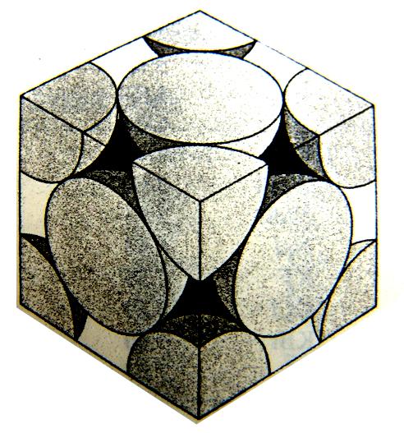
Packing Fraction (Hint for FCC)

